Slide 1
ANCIENT SUMER

Slide 2
Mesopotamia
“Land Between the Rivers” or
“Fertile Crescent”
What are the 2 rivers?

Slide 3
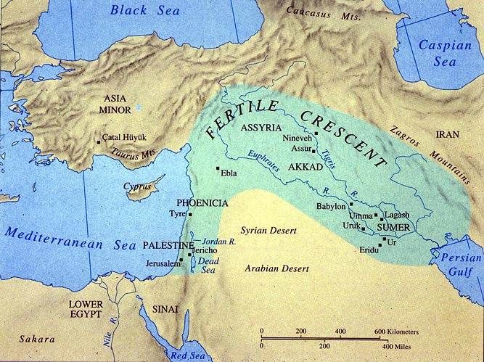
The Tigris and Euphrates

Slide 4
Fertile Crescent
Spanned from the Persian Gulf to the Mediterranean Sea.

Slide 5
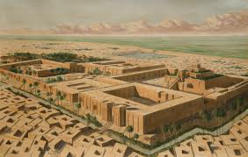
SUMERIAN CITY-STATES
3200 B.C, **first city-state founded in SUMER**
**City-state---an independent self-governing community that included a city and surrounding farmland

Slide 6
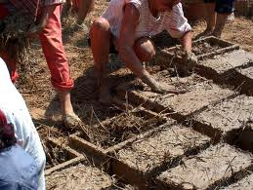
No Lumber…..so how did they build?
Used straw, water, and mud to make clay bricks, then baked them in the sun.

Slide 7
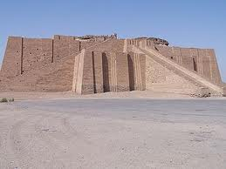
Ziggurat
*** Means “to be high” or “pointed”
Built to reduce the distance between the people and their gods. Different levels were for different steps leading to the gods.
The center of social and economic life. Around the base, the home of priests and shops of artisans were located.

Slide 8
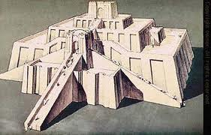

Slide 9
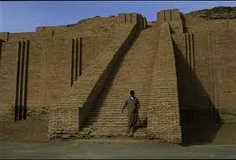

Slide 10
Transportation and Trade

Slide 11
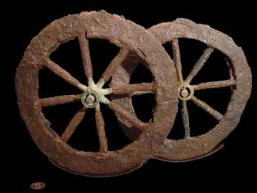
Drained swamps, built dams, and irrigation canals
The wheel and sail made transportation easier.
**First wheels were made from three planks of wood that were clamped together with copper or wooden braces ad then cut to form a circle.

Slide 12
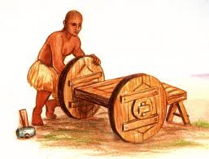

Slide 13
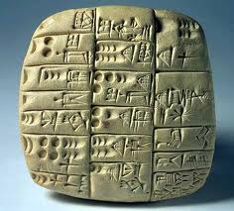
Cuneiform
Writing on clay tablets
Scribes use a stylus---sharp pointed stick to write pictures on the tablet

Slide 14
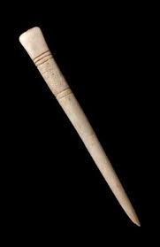
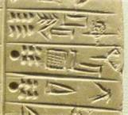
Scribes use a stylus---sharp pointed stick to write pictures on the tablet

Slide 15
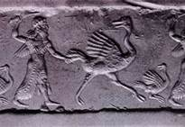
***Signature Seals**
Show scenes of everyday life

Slide 16
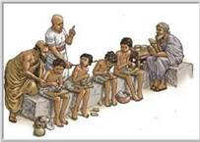
Schools
Only the rich and boys could go to school to learn to write in cuneiform.

