Slide 1
The Coming of Independence

Slide 2
Britain's Treatment of the Colonists
At first, colonists governed themselves
Later changed, colonists taxed more to support British troops in N.A.
Idea was born -
“Taxation without representation”

Slide 3
Albany Plan
Several States came together to protect trade markets and attacks from Native Americans / French.
Could raise military forces, make war, peace and collect taxes from N.A.
Britain rejected it.

Slide 4
Stamp Act
Intolerable Acts
All legal documents, newspapers, and business agreements taxed by B.
Colonies united, B took away tax
Eventually leads to Boston Massacre
Boston Mascrre
Later the Boston Tea Party.
Intolerable acts

Slide 5
First Continental Congress
B passes more laws taxing colonists in 1774 as punishment for Boston Massacre.
Leaders such as John Adams, G.W, Sam Adams met in Philadelphia to discuss problems.
Urged all colonies to stop trade with B until they took taxes and regulations.
Sent Declaration of Rights to B.

Slide 6
2nd Continental Congress
B continued to impose strict taxes
Army created, G.W. chosen as commander.
Fight with B begins.
2nd C.C. became 1st national government for 5 years.
2nd congress

Slide 7
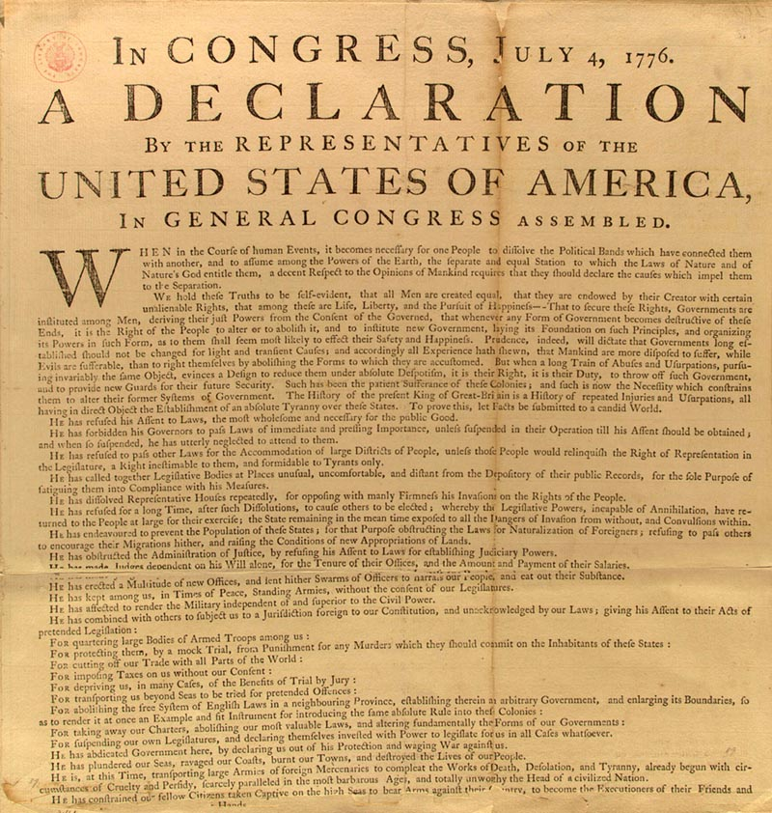
Declaration of Independence
Colonies “declare” their independence from B.
States existence of new nation
Most of document focuses on how B has mistreated colonists
John Adams

