Slide 1
Consumer Scams
Chapter 1 , Section 3 & 4

Slide 2
Key Terms
Identity Theft – Illegal use of a persons information
Social Security Number – a 9 digit # used to keep track of a persons earnings
Secure Site – websites that uses safeguards to protect peoples personal information
Online Profiling – tracking purchases of buyers
Cookies – files to remember information about a visitor.

Slide 3
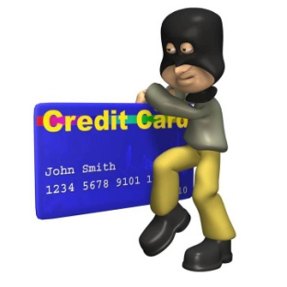
Preventing Identity Theft
15 million people a year affected
Carry only the identification information and the number of credit and debit cards that you'll actually need
Do not carry your SSN card; leave it in a secure place.

Slide 4
Preventing Identity Theft
Never give your credit card number, social security number, or other personal information over the phone
Carefully examine the charges on your credit card and bank statements.
Protect your personal information on your computer by installing a firewall and updating your virus protection.

Slide 5
Idetity Websites
http://www.spokeo.com/
http://www.zabasearch.com/

Slide 6
Deceptive Advertising
Misleads consumers through false statements, omitted information, and other unfair means
Intended to get something extra from a person.
credit report commercials
Credit report video

Slide 7
Types of deceptive advertising
Bait and switch
Def - When a retailer advertises a product that is has no intention of selling hoping that customers will buy something at a higher price
i.e. No $99 t.v, buy the more expensive one

Slide 8
Types Cont.
False promise of free gifts
Def - You will get a gift but only if you buy something
i.e. Buy a car, get a free dinner

Slide 9
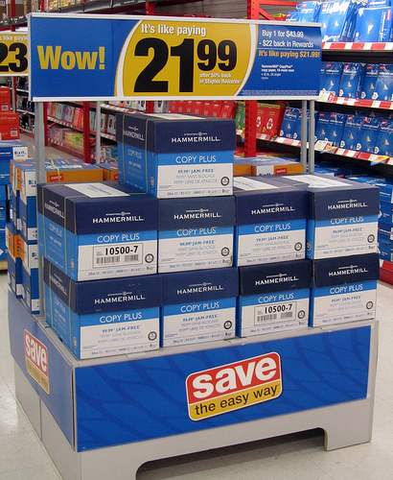
Types Continued
Deceptive Pricing
Def - When the sale price is no better then the original price of the item
i.e. - Stores raise the price of an item, then lower it and call it a sale

Slide 10
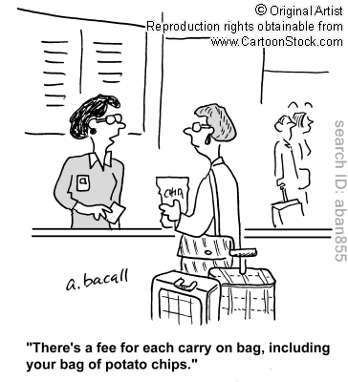
Types Continued
Hidden Catches
Def- Extra charges and requirements for purchasing a certain item on sale
i.e. Processing fees, requirements to stay in certain hotel
Hidden fee

Slide 11
Pyramid Schemes & Fraud
deceitful conduct designed to manipulate another person for gain
Def – an illegal get rich quick plan
Gets people to contribute based upon false promises
Pyramid scheme

Slide 12
Chain letter
Chain letter
Big payouts to people who participate in the letter.

