Slide 1
The Magna Carta
Limited Monarchy
The Tower of London

Slide 2
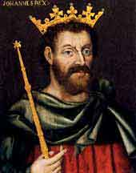
Introduction. . .
*King John*
  Ruled from 1199-1216
  Much disliked
    Demands for high taxes
      King John was involved in a lot of wars
    Other actions (many oppressive)
      Repeated violations of common law
      Clash with Rome over vacancy of the Archbishop of Canterbury
  Barons eventually rebelled against him

Slide 3
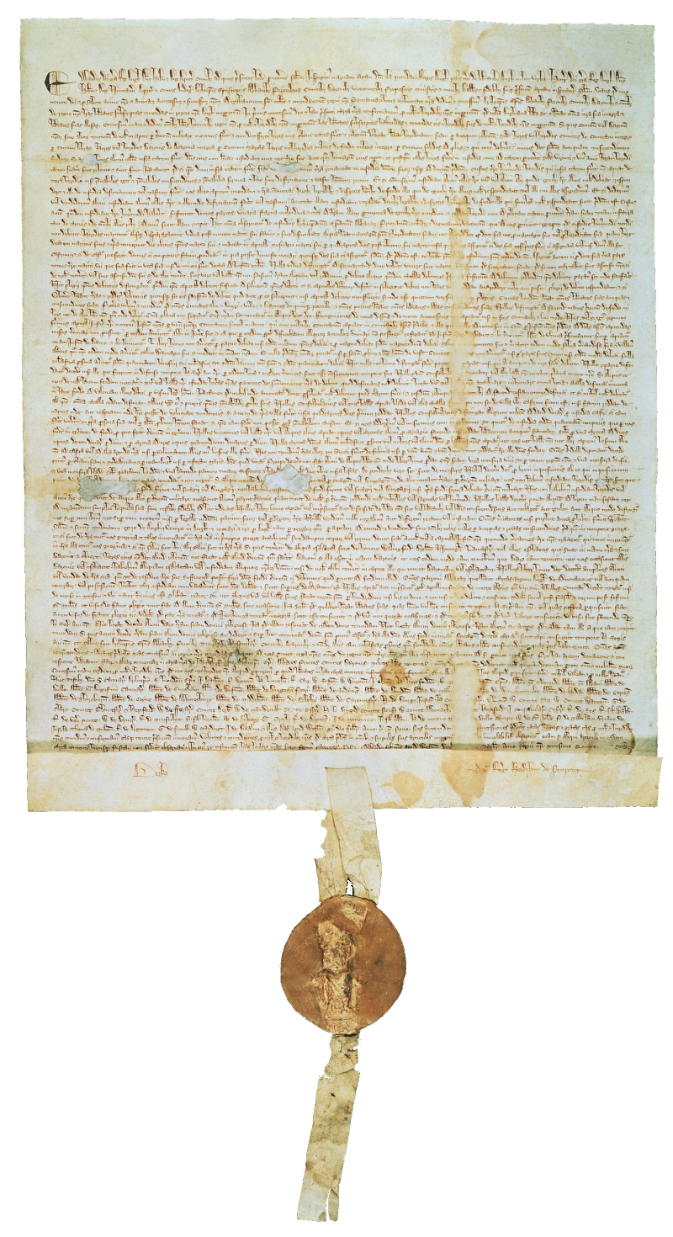
I. *The Magna Carta*
“Great Charter”
Signed in 1215
The king agrees to recognize the rights and privileges of the barons
Recognizes three key rights

Slide 4
1. Taxation only with representation
States that no unusual taxes “may be imposed in our kingdom except by the common council of our kingdom”
This came to mean that the English monarch needed the approval of the representatives of the people to impose taxes

Slide 5

2. Right to trial
“No freeman [can] be taken or imprisoned or dispossessed or banished or in any way destroyed . . . except by the lawful judgment of his peers or by the law of the land.”
Originally meant that those accused of a crime would be tried by their fellow barons . . .

Slide 6
In time, this expanded to mean that any accused person had a right to a trail by jury
Could not be imprisoned unless found guilty in court.

Slide 7
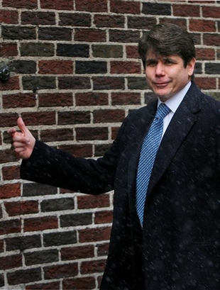


3. Limits to power
Monarchs could not rule any way they pleased
Monarchs had to govern according to the law
This part is why Rod would have never been a successful king.

Slide 8
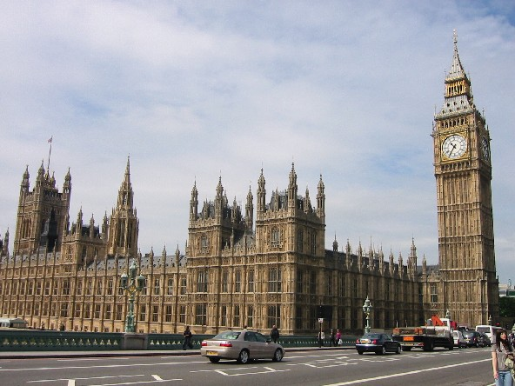
II. Limited Monarchy
Limited Monarchy – a government in which limits are set on the ruler’s powers.
*Magna Carta* protected basic rights of the people
Other limits on power grew out of the development of the English Parliament

Slide 9

How Parliament is set up. . .
HOUSE OF LORDS
HOUSE OF COMMONS
Bishops
Great Nobles
Lesser land-owners (knights)
Townspeople

Slide 10
Parliament
Control of Finances
  Parliament’s power grew over the years because it controlled money issues
  Monarchs needed the approval of Parliament to raise taxes
Without higher taxes, monarchs could not:
  Build roads
  Increase their officials’ salaries
  Pay the expenses of keeping an army

Slide 11
The English rulers were constantly in need of more money. To get this money, however, they had to turn to Parliament, and ask for Parliament’s help.
If you were in Parliament, how would you respond?
How do you think the actual members responded?

Slide 12
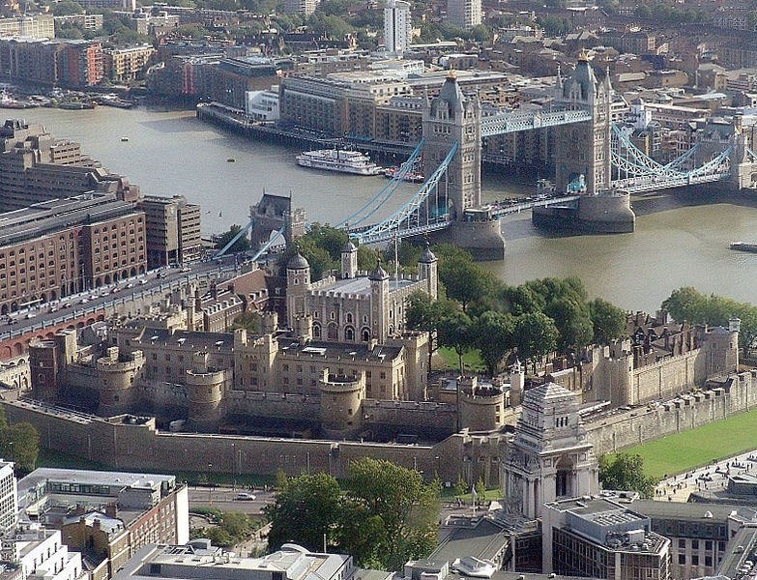
The Tower of London

Slide 13
The Tower of London
William the Conqueror built strong castles at key points all over the country
Filled the castles with Norman soldiers
Why?
  Main goal was to keep the English people under control.
  London, the most important city, was said to have had a “vast and fierce populace.”

Slide 14
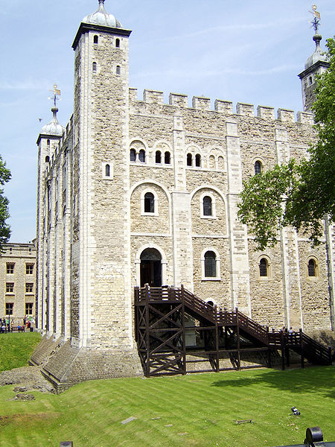
Making the Tower. . .
Location was carefully chosen – on a hill, near the Thames River
The stone tower was completed in 1078.
  Central tower is known as the “White Tower” because of its limestone
Later kings built many additions to the tower
SW view of the White Tower

Slide 15
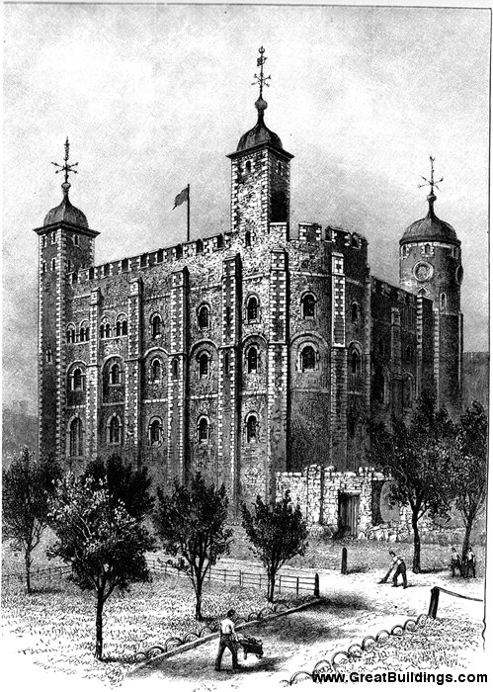
Purpose of the Tower
Original purpose?
  Keep Londoners in line, protection of and from them.
In the following centuries?
  Royal residence, fortress, prison, zoo
Served as a scene for battles, banquets, riots, robberies, public executions, secret murders, and terrorist bombings

Slide 16
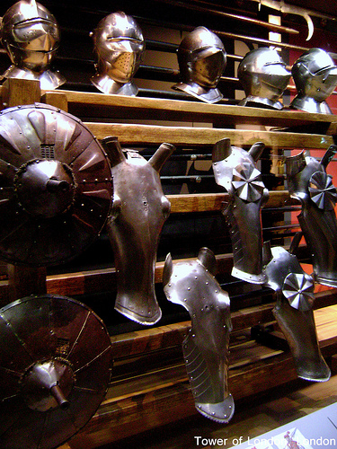
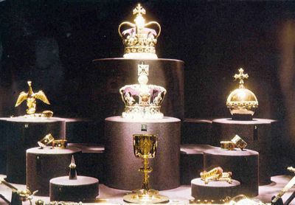
The Tower of London, today . . .
Mainly a tourist attraction
  Historical site
  Collection of armor
Britain’s crown jewels are on display at the Tower of London

Slide 17
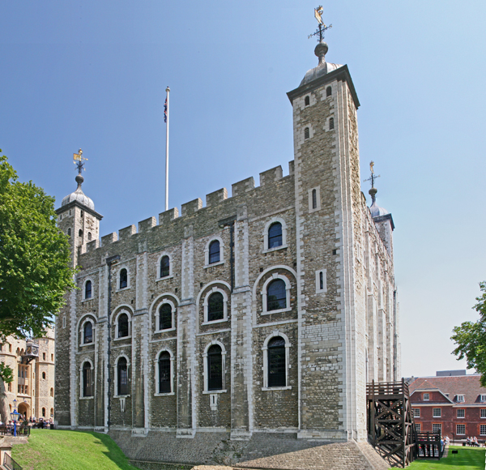
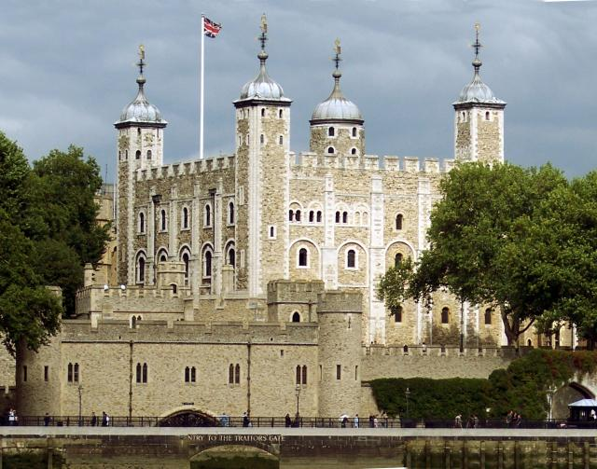
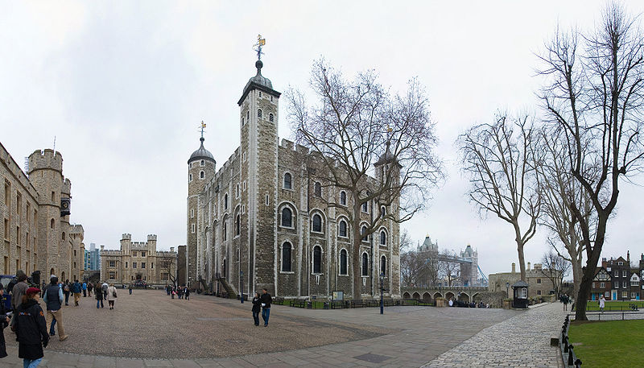
The White Tower

Slide 18
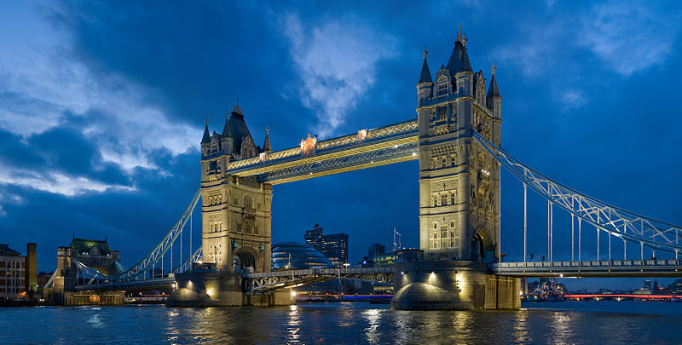
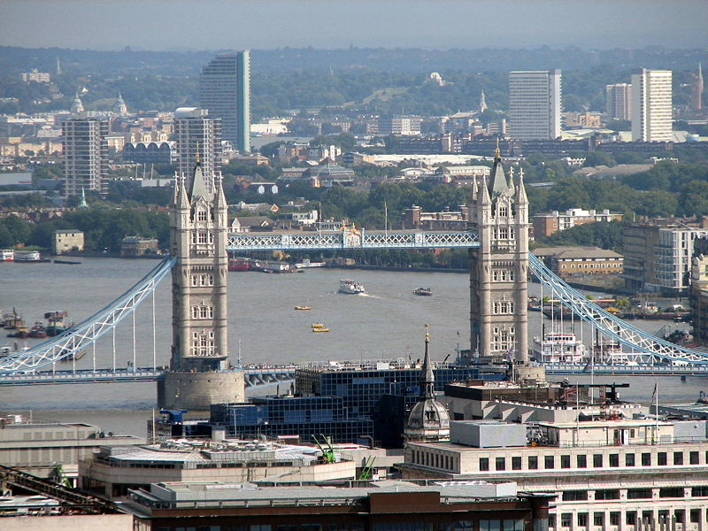
Tower Bridge
-Not technically part of the Tower of London, but still a key landmark associated with it.

Slide 19
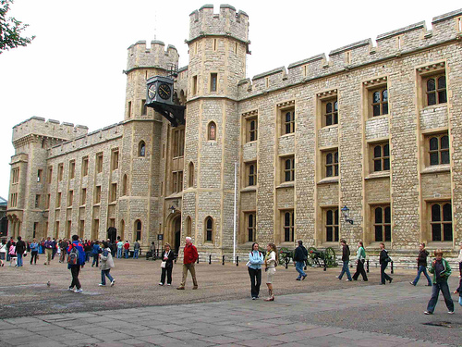
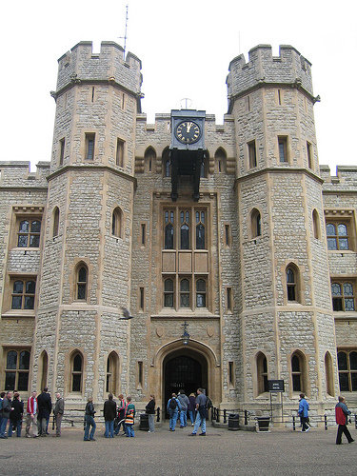
The Jewel House

Slide 20
Who was the king who had to sign the Magna Carta?
  1. Henry IV 2. William the Conqueror
  3. John 4. Henry II
  Name the traditions and developments in government that happened under John’s reign.

