Slide 1
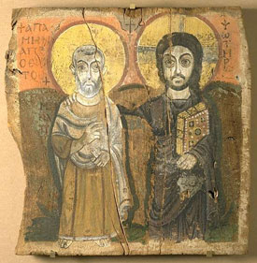
Christianity

Slide 2
Objectives
Explain Rome’s policy toward different religions in the early empire.
Describe the major teachings of Jesus and how they were spread.

Slide 3
Key Terms
Messiah
Herod

Slide 4
People/Peoples
Jesus
Augustine

Slide 5
Religion
In your own words…define religion

Slide 6
Religion and Government
Why might the religious beliefs of citizens be a matter of concern to government officials?
Religious beliefs affect people’s attitudes and behavior as citizens. In some governments, officials may see religion as a threat to political and social order.

Slide 7
Religion and Government
How might religious beliefs conflict with the interests of the state?
Military policy, social legislation, or educational standards may at times be inconsistent with the religious beliefs of some groups.

Slide 8
Religion and Government
How are conflicts between religious beliefs and government interests dealt with in today’s world?
Some governments – such as communist nations – restrict the expression of religions. Governments may restrict or outlaw certain religious practices, for example, polygamy. The First Amendment to the U.S. Constitution guarantees freedom of religion and forbids the establishment of a state religion.

Slide 9
Religious Toleration
With a partner…
Discuss Rome’s policy toward religion in the Empire.
You will have 2 minutes to finish this question.

Slide 10
Religious Toleration
People were allowed to keep many of their own religious customs.
Hebrews or Jews, had considerable religious freedom.
Other conquered peoples were required to show their loyalty to Rome through rituals honoring the emperor.
Jews did not have to take part because of their belief in one God.
Rome established a line of Jewish kings named Herod on the throne in Judaea.

Slide 11
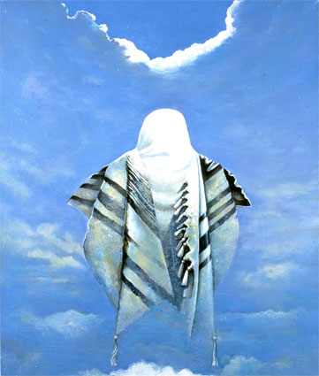
Messiah
Define Messiah
Savior
The Jews were wishing for the messiah to come and give them freedom from the Romans and bring an age of peace and prosperity.

Slide 12
Teachings of Jesus
In a group of 4…
You will design a mind-map describing Jesus’ life.
You will have 5 minutes to complete this assignment.

Slide 13
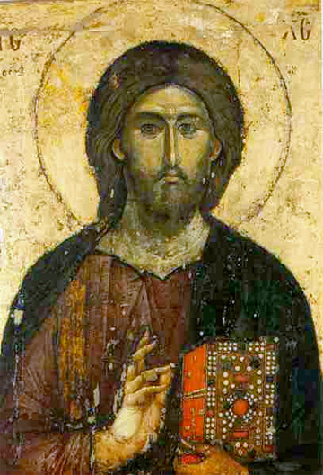
Teachings of Jesus
Morality – doing good
Forgiveness
***Salvation***
Do unto others
Give to poor
Turn the other cheek

Slide 14
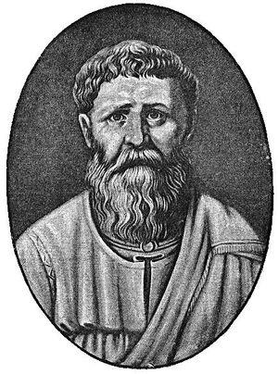
Teachings of Augustine
Define “Fathers of the Church”
Early Christian thinkers and writers
Social unrest started back up in the 400’s with the barbarian invasions.
People thought that the ancient gods were punishing the Romans

Slide 15
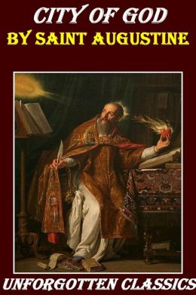
Teachings of Augustine
Augustine wrote a book called The City of God.
It outlined what a true Christian should be.

Slide 16
According to Augustine, what is a true Christian?
A citizen of a heavenly city that could never be destroyed by ungodly barbarians.
Only an individual’s salvation mattered not the cities or empires.
Christians should try to run their earthly city according to Christian principles and teachings.
The aim in life was the fulfillment of God’s will.

Slide 17
Objectives
Explain Rome’s policy toward different religions in the early empire.
Could worship whom ever they wanted as long as you worshipped the emperor.
Describe the major teachings of Jesus and how they were spread.
Need justice, morality, and service to others.

Slide 18
Key Terms
Messiah
Savior
Herod
A line of Jewish Kings

Slide 19
People/Peoples
Jesus
Christian savior
Augustine
Wrote the “City of God”

Slide 20
Christianity

