Slide 1
Christianity

Slide 2
Objectives
Summarize how the early Christian Church developed.

Slide 3
Key Term
Martyr

Slide 4
People/Peoples
Paul

Slide 5
Growth of Christianity
In a group of 4…
Your group will make a mind-map of the growth of Christianity.
You will have 5 minutes to complete this assignment.

Slide 6
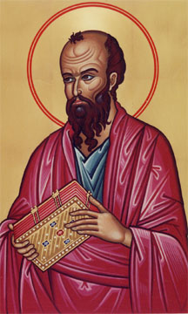
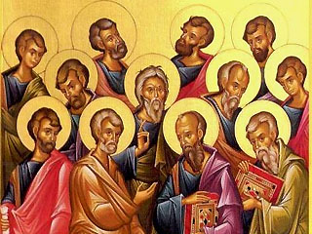
Growth of Christianity
Disciples
Role of Paul
Sources of Unity

Slide 7
From persecution to acceptance
As more and more people turned to Christianity, Roman officials began to see it as a threat to their rule.
In What ways were the Christians a threat to the Romans?
The Christians did not accept the Roman Gods or celebrate their festivals.
They refused to worship the emperor as a god.
Romans found some Christian ways strange.
Christians stayed away from the gladiatorial contests and at times refused to serve in the army.

Slide 8
Persecution
64, Rome caught on fire and Nero blamed the Christians for it.
He began systematic persecution of the Christians.
How did Nero persecute the Christians?
Lost their property
Were imprisoned
Executed
Sent to face wild beasts in the arena
Define Martyrs
People who suffer or die for a cause

Slide 9
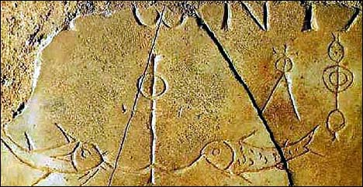
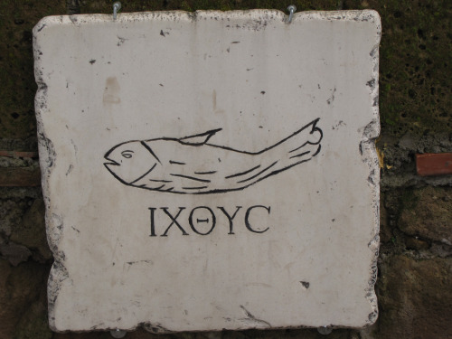
What was the earliest symbol of the Christian Church?

Slide 10
Acceptance
The invasions and unrest of the third century brought more converts and new strength to the Christian Church.
In 312, Constantine converted to Christianity, he became the first Christian Emperor.
380 – Emperor Theodosius I declared worship of the old gods to be illegal.
Christianity soon became the official religion of the Empire.

Slide 11
Objectives
Summarize how the early Christian Church developed.
Missionaries spread the word, salvation was appealing to the poor and all were equal.

Slide 12
Key Term
Martyr
Someone who dies for his or her beliefs.

Slide 13
People/Peoples
Paul
Letters are in the Bible.

Slide 14
Christianity

