Slide 1
Decline of the Republic

Slide 2
Objective
List the steps of the decline of the Roman republic.

Slide 3
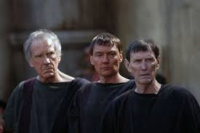
People/Peoples
Tiberius and Gaius Gracchus

Slide 4
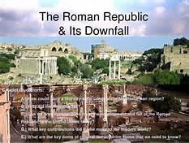
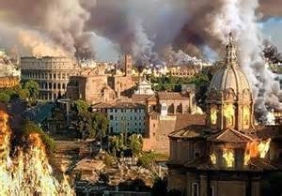
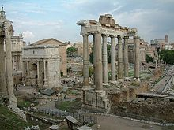
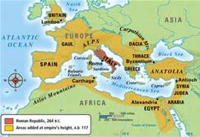
Decline of the Republic
List the steps that led to the decline of the Roman Republic

Slide 5
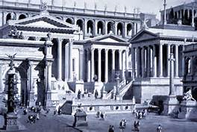
Decline of the roman republic
Make a time line or list the steps that led to the decline of the Republic
Make sure you use dates & specific event/names (p133-135)
Your group will have 15 minutes to this assignment
GO! GO! GO!

Slide 6
Items to list
Slave Labor
Conquered Lands
Brothers
What did they do?
What happened to them?
Farmers
Moving
Riots?
Corruption

Slide 7
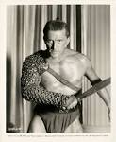
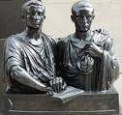
Decline of the Republic
Your time line should have included…
Farm debts
Unemployment
Attempts to reform - Gracchus Brothers
Social and political disorder
Slave revolt - Spartacus

Slide 8
Objective
List the steps of the decline of the Roman republic.
Civil wars, slave revolts, poor leadership

Slide 9
People/Peoples
Tiberius and Gaius Gracchus
Brothers who were killed in street violence because they fought for land reform.

Slide 10
Decline of the Republic

Slide 11
Quiz on Sections 1 & 2
You have 5 minutes to review your notes from the past two days.
Remember to look over everything…Roman army, to soldiers, to the decline of the republic.

