Slide 1
Diocletian, Constantine, Division, Barbarian Invasions, and Fall of the Empire

Slide 2
Objectives
List how the Roman emperors tried to end the crisis in the empire
Describe how the Hun invasions contributed to the decline of Rome
List how economic and social problems lead to the fall of Rome

Slide 3
People
Constantine
Theodoric
Diocletian

Slide 4
Dates
33
285
330
476

Slide 5
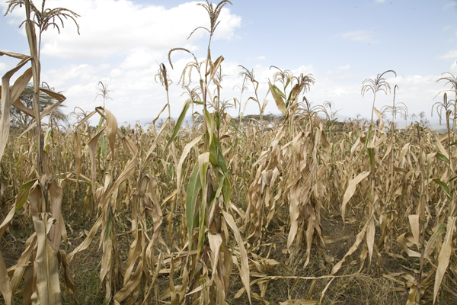
What factors might contribute to the disintegration of an empire as successful as Rome’s?
Too expensive to control such a large empire
Disease
Poor crops
invasions

Slide 6
Does the history of other civilizations already studied suggest a pattern of rise and decline?
All usually go through a slow development , great achievement, and gradual decline.
Decline is sometimes caused by civil unrest or foreign threats

Slide 7
What crises faced the Roman Empire? P. 147
Discipline in the army broke down
Rome’s territories were invaded by foreign troops
Plague spread through towns
Crimes went unpunished
No money in treasury
Inflation
Food supplies were short
Empire was split into 2 parts

Slide 8
Diocletian and Constantine try to save the empire.
Impose a one man rule
Took away more liberties from the people
Ordered farmers to stay on land---kept food supplies high
Government workers and artisans also had to keep their jobs for life
Children were forced to follow their father’s occupation
Raised taxes to a crippling level

Slide 9
Effects
People lost freedom
Tax collectors had to pay the difference of money that they did not collect
Many artisans and merchants were ruined financially
Romans’ lost faith in the economy, caused a decline in city life

Slide 10
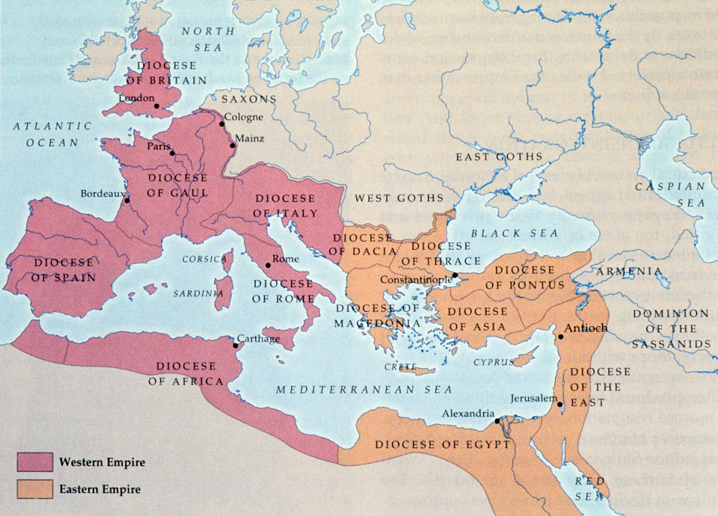
Division of the Empire
**285—Diocletian moved the Imperial Court to Asia Minor and ruled from there
Rome was no longer the center of the Empire
Why is this significant?

Slide 11
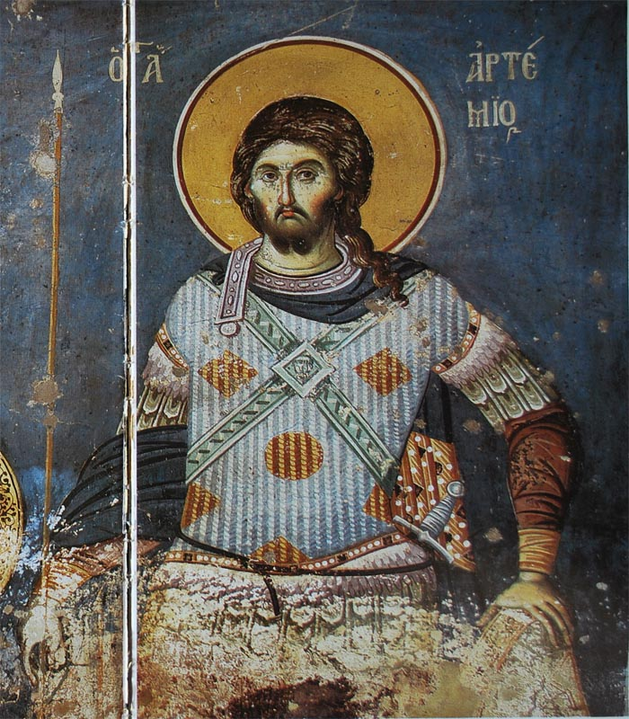
Division of the Empire
**330—Constantine built a new capital at Constantinople
Made Christianity the official religion of Rome
Issued the Edict of Milan

Slide 12
Consequences of Division
Western Empire had to pay for troops and border defenses to keep out invaders.
The Roman army became made up of mercenaries and Germanic people
The division of the Empire restored order, but it delayed the collapse it did not prevent it.

Slide 13
Barbarian Invasions p. 149
Huns reach eastern Europe looking for a place to settle
Roman legions couldn’t stop them
Rome surrenders Britain , France, and Spain
Visigoths invade the western part of Rome
Vandals invade Gaul, Spain , and North Africa
434, Attila, leader of the Huns , attacks much of Europe
476 Odoacer defeats the Roman emperor***Fall of Rome**

Slide 14
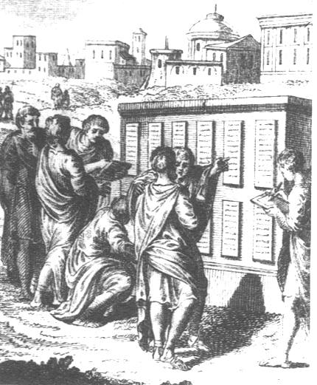
Some Roman traditions carried on
Law
Art forms
Architecture
language

Slide 15
https://www.youtube.com/watch?v=XPQ3dm1B-Xk

Slide 16
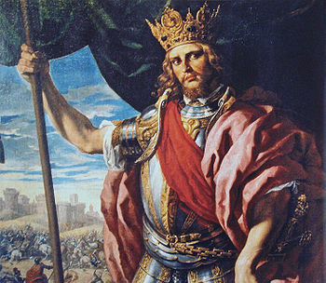
Theodoric
493 Theodoric –kills Odoacer and becomes king
He restore peace and prosperity to Italy
Reigns until 526

Slide 17
Causes and Effects for the Fall of the Empire
Weakened empire
Smaller population
Oppressive government
Declining farms and cities
Stagnant economy
Loss of confidence in Empire
Barbarian invasions
Rome ruled by invaders
End of Rome as center of power
Flight of nobles to country estates
Loss of wealth from the provinces
Further loss of population

Slide 18
Objectives
Explain how the Roman emperors tried to end the crisis in the empire
Divided empire in 2, fixed prices to slow inflation
Describe how the Hun invasions contributed to the decline of Rome
Legions could not keep the Huns out of Rome
Explain how economic and social problems lead to the fall of Rome
Mercenaries fill the legions, no loyalty, too many taxes, poor get poorer

Slide 19
People
Constantine
Made Christianity the official religion of Rome/Constantinople new capital in 330
Theodoric
Last emperor to rule over both Rome
Diocletian
Divided Rome in 2

Slide 20
Dates
33
Jesus crucified/Disciples
285
Diocletian moves imperial court
330
Constantine builds Constantinople
476
Fall of Rome

Slide 21
http://www.youtube.com/watch?v=me4E5wDCK2Q&list=PL13C0BC50E3137540&index=22

Slide 22
Diocletian, Constantine, Division, Barbarian Invasions, and Fall of the Empire

