Slide 1
Italian City-States Recovery of Classical Culture

Slide 2
Objectives
Describe why the Italian city-states were a favorable setting for a cultural rebirth.
Summarize the renaissance

Slide 3
Key Terms
Patron
Humanism
humanities

Slide 4
People
Lorenzo de Medici
Machiavelli
Francesco Petrarch

Slide 5
Renaissance
**Begins in 1350 and lasts until 1527**
**Means rebirth**
Rebirth of what?
The old classical cultures
Time of creativity and change in social , political, economic, and cultural arenas

Slide 6
Humanism
Changed view of themselves and the world
Interest in classical culture gave rise to the humanities, which included Latin and Greek language, literature, composition, history, and philosophy.
Gave rise to Humanism, a movement in thought which focused more on human and worldly concerns rather than just religious issues.

Slide 7
Italian City-States
Why did the Renaissance begin in Italian City –States?
Geography—natural gateway between the East and the West
Good for an exchange of ideas and culture
Black Death hit Italy early, but also left there first
Wealthy *patrons, or financial supporters of the arts*

Slide 8
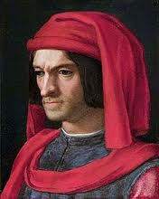
Medici Family
Banking family from Florence
Greatest Lorenzo the Magnificent
Scholar, architect, poet
Collected a huge library
Expanded the University of Florence
Hired artists to create works of art for his palace.

Slide 9
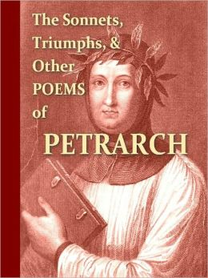
Petrarch
Considered to be the “father of humanism”
Collector of ancient manuscripts
Rediscovered a number of Roman authors whose work had been forgotten
As a poet, Roman texts served as an inspiration for his own work
Found dead in his library while working on his writing.

Slide 10
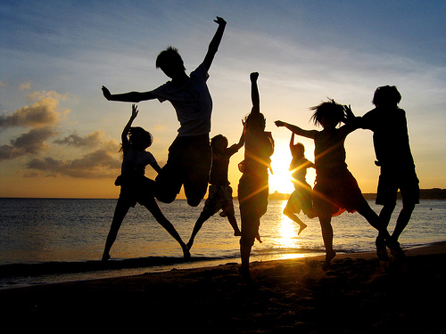
New Attitudes
Interest in earthly life
Humanists tried to understand the civilizations of the ancients/MA support and clarify church teachings
**Humanists believed that life should be lived to the fullest/MA earthly existence a preparation for the after life.

Slide 11
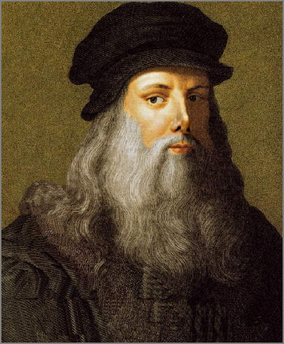
Focus on the Individual
Interest in unique qualities that made one person stand out
Ideal Renaissance person: educated, witty , charming, and artistically creative
Military and athletic skills also a plus.

Slide 12
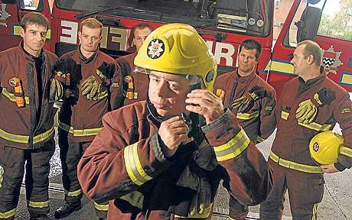
Public Service and Politics
Valued public service like Romans
Believed education in the humanities was a sound preparation for life
Political climate was one of intense rivalry

Slide 13
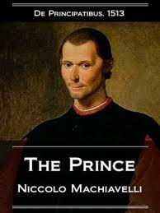
Niccolo Machiavelli
*Wrote The Prince –a guide book for effect ruling*
*Pointed out that rulers often lied, broke treaties and killed, but actions must be judged only by their results.*

Slide 14
Role of Women
Make use of education and talents at home
Rich ladies studied poetry, languages, and music to entertain their husbands

Slide 15
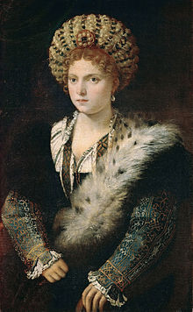
Isabella d’Este
Patron of the arts and learning
Diplomat
Renaissance women were better educated than Medieval women, but still had little chance to shape economic and political life.

Slide 16
Objectives
Describe why the Italian city-states were a favorable setting for a cultural rebirth.
Centrally located, wealthy bankers who supported art
Summarize the Renaissance
Period of rebirth, creativity, changes

Slide 17
Key Terms
Patron
Wealthy supporter of the arts
Humanism
Intellectual movement that focused on human and worldly concerns
Humanities
Study of subjects such as grammar, rhetoric etc.

Slide 18
People
Lorenzo de Medici
Wealthy banker and patron of the arts
Machiavelli
Wrote The Prince
Francesco Petrarch
Humanist who created a library of ancient works

