Slide 1
Manorial System , serfs

Slide 2
Objectives
Summarize feudal life for nobles and peasants.
Explain the basis of the manor economy.

Slide 3
Key Terms
Serf
Manor
Three-Field System
Self-sufficient

Slide 4
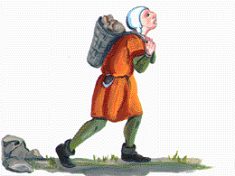
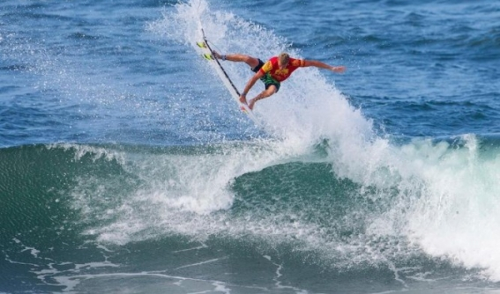
Serf
Peasant tied to the land.
**Largest population
Not surf’s up!!

Slide 5
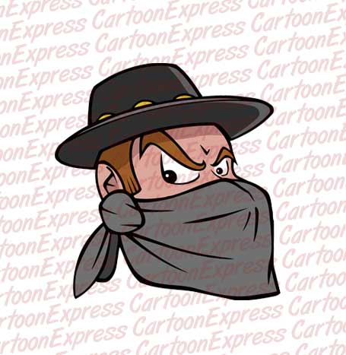
Manor
Lord provided:
The Lord’s estate
Serf came with the land
Manorial system—basic economic system
Housing for the serfs
Land to farm
Protection from bandits

Slide 6
Manor---Self-sufficient community
What is self-sufficient?
Why did they need to be self-sufficient?
independent
Too dangerous to go outside of the protected area.
Everything they required had to be on the manor

Slide 7
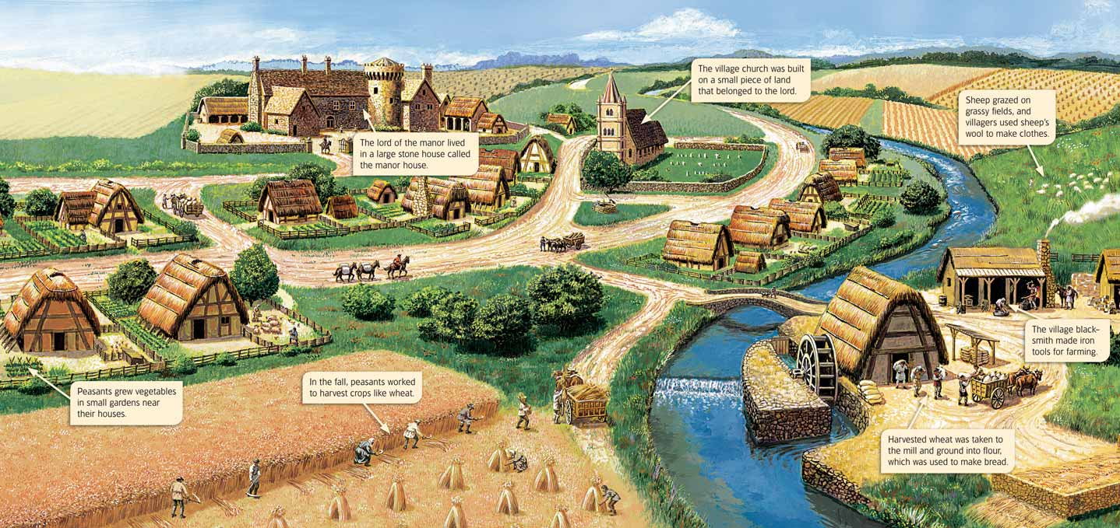
What are the parts of a Manor?
15-30 families
Serf’s cottages
Lord’s castle or manor house
Church
Workshops
Surrounding villages, fields, pastures and forests.

Slide 8
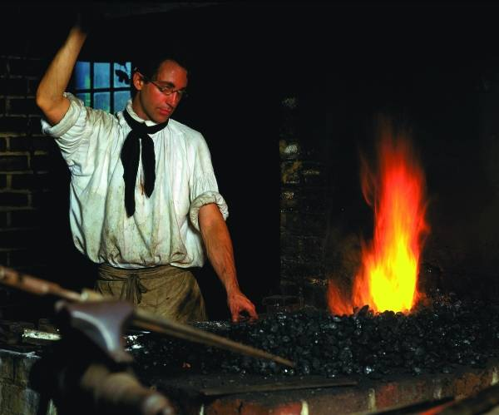
Goods and Services produced
Serfs raised grain and other crops
Carpenters and stone masons did the building and repairing
Blacksmiths made the weapons and tools.
Women spun thread into fabric
Priests tended to religious needs

Slide 9
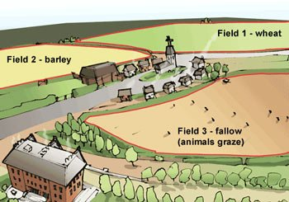
Farming Methods
Planting the same crop in the fields caused the soil to lose its nutrients.
Three field system
1/3 winter wheat
1/3 oats and vegetables
1/3 fallow ---unplanted

Slide 10
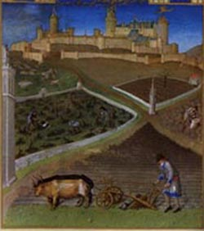
Land was divided into strips
Most strips were the lords some were the peasants.
Not all the land had the same fertility( so serfs were given a strip to different fields.

Slide 11
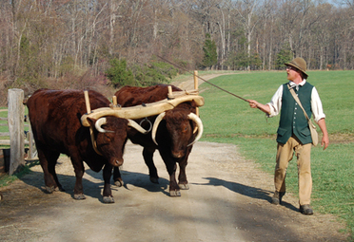
Serfs shared their oxen and labor with each other.
Each family received their goods from their strip.

Slide 12
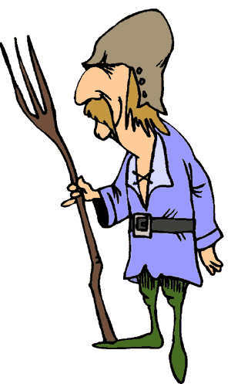
Life of a Serf
Farm the land
Bake bread, grind wheat, press grapes for wine (they had to pay for these by giving the lord part of their crops.

Slide 13
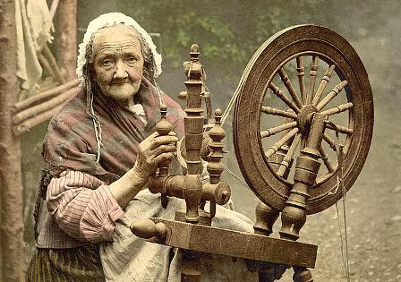
Women made clothing for the lord’s family
Each serf worked about 3 days a week for the lord
Serfs could not leave the manor without the lord’s permission

Slide 14
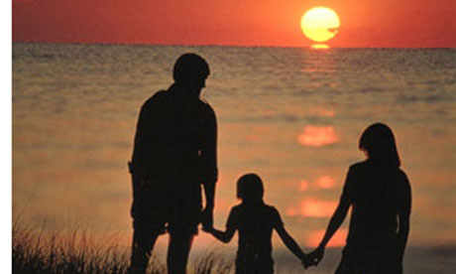
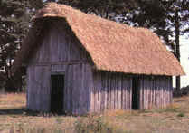
Rights
Children could not be taken from them
Permission to live in their cottage and work their land.

Slide 15
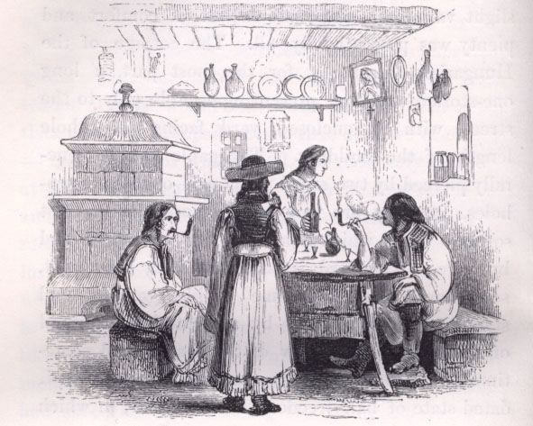
Living Conditions
Crowded houses
Earth packed floor
Few furnishings

Slide 16
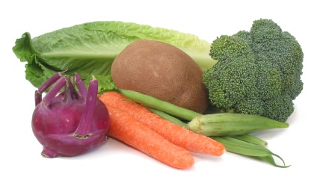
Diet
Fresh meat, milk, and butter were luxuries
Mostly ate vegetables, bread, grain, cheese and soup

Slide 17
And…
Hard life
Worked from sun-up to sun down
For fun---traveling minstrels and entertainers, wrestling, soccer.

Slide 18
Unquestioned order
Serfs accepted their life because they believed God determined their place in society.
Some serfs became clergy or knights
Most stayed in their same group for life

Slide 19
Objectives
Summarize feudal life for nobles and peasants.
Nobles were wealthy landowners. Peasants worked the land for the nobles.
Explain the basis of the manor economy.
The manor had to be self-sufficient due to the fighting.

Slide 20
Key Terms
Serf
Their work on the manor provided the main wealth.
Manor
The lord’s land
Three-Field System
Rotating crops to preserve the soil…led to more crops.
Self-sufficient
Independent functioning…a manor was to be this.

Slide 21
Manorial System , serfs

