Slide 1
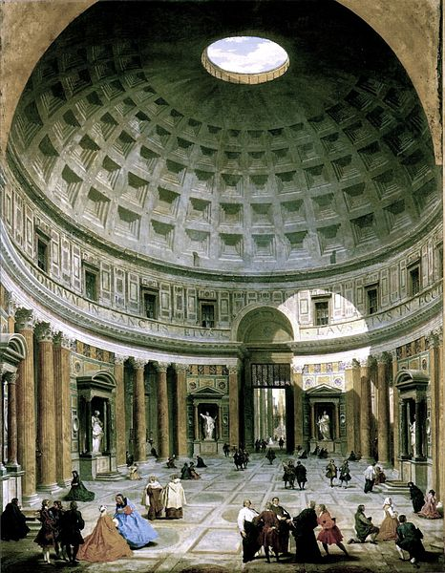
Roman Religion and Literature

Slide 2
Objectives
Explain how Greco-Roman civilization was formed.
List the Roman contributions to literature, the arts, and technology.

Slide 3
People/Peoples
Ovid

Slide 4
Today is the leap frog challenge

Slide 5
Religion
Leap, hop, to a partner.
What were the main features of Roman religion?
You will have 3 minutes to complete this assignment.

Slide 6
Features of Roman religion
Worshipped many gods and goddesses
Practiced ancestor worship
Gods…
Jupiter – god of sky – Zeus
Mars – god of war – Ares
Diana – Goddess of the moon – Demeter
Juno - Hera

Slide 7
Features of Roman religion
Morality was not a major concern
They believed that the gods’ only demand was to be properly respected
They preformed complex ceremonies to earn the gods’ favor
Romans viewed changes in nature as signs from the gods

Slide 8
Leap Frog #2
Leap, hop, to a new partner.
List the steps for the decline in Roman religion.
You will have 2 minutes to complete this assignment.

Slide 9
Decline of Roman religion
It offered no…
Moral code
No emotional warmth
No promise of an afterlife

Slide 10
Leap Frog #3
Leap, hop, to a new partner.
List the steps in the development of the Greco-Roman culture.
You will have 3 minutes to complete this assignment.

Slide 11
Greco-Roman Culture
They adopted many Greek items. Libraries and works of art.
Greek teachers, poets and philosophers came to work in Roman households.
Some Romans sent their sons to Athens to study.
Romans preserved and spread the Greeks’ devotion to excellence and their use of reason.
Romans added their organizational ability, skill in engineering, and a talent for government and law.

Slide 12
Leap Frog #4
Leap, hop, to a new partner.
List the Roman author and the books that they wrote and what each book was about.
You will have 2 minutes to complete this assignment.

Slide 13
Roman Authors
Virgil – Aeneid – Praising the Roman talent for governing.
Livy – History of Rome – Described key figures from Rome’s past in an uncritical, colorful style.
Horace – Wrote that human greed had caused these conflicts and he criticized the luxurious lives of many wealthy Romans.
Ovid – He wrote of wealth, fashion, romance, and other pleasures.

Slide 14
Objectives
Explain how Greco-Roman civilization was formed.
Blending of Greek and Roman cultures.
List the Roman contributions to literature, the arts, and technology.
Ovid retold Greek and Roman myths, aqueducts, Colosseum, Circus Maximus were built.

Slide 15
People/Peoples
Ovid
Roman poet/retold both Greek and Roman myths.

Slide 16
Roman Religion and Literature

