Slide 1
The Critical Period
Origins of American Government

Slide 2
Objectives
1. I can name the strengths and weaknesses of the Articles of Confederation
2. I can state why the early Americans believed the Post-Revolutionary government needed to be changed

Slide 3
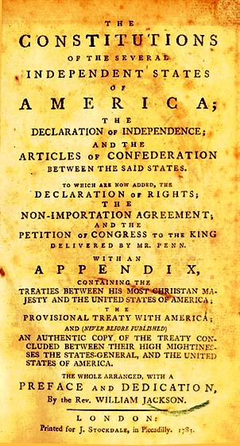
The Articles of Confederation
Nov. 15th, 1777 created
Ratified—Mar. 1, 1781
Established a firm league of Friendship
States kept freedom, independence, and every power and Jurisdiction
States formed common defense and general welfare.
http://www.youtube.com/watch?v=fbP0JWQeXag

Slide 4
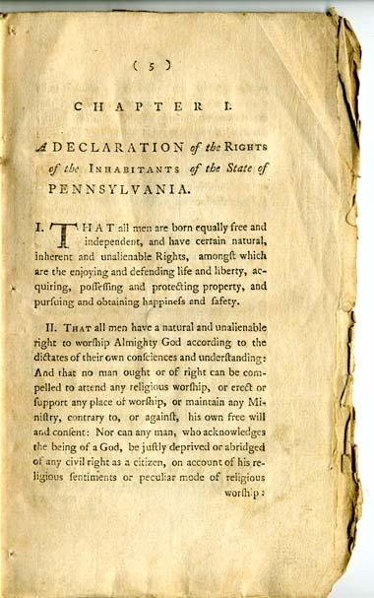
Governmental Structure
A congress was created
No Judicial Branch
Each state had one vote in Congress
Members of Congress chose the President from Congress every year.
However, not called President, called presiding officer.

Slide 5
Powers of Congress
Congress Could
Make war and peace
Make treaties
Borrow money
Set up a money system
Establish a post office
Build a Navy and Army
And settle disputes among States

Slide 6
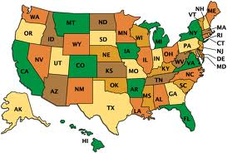
State Obligations
Obey Congress
Treat each other fairly
Surrender fugitives from one state to another
Must protect Life and Property

Slide 7
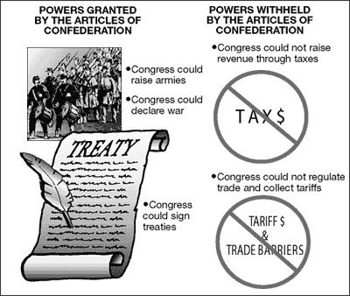
7 Weaknesses of the Articles
1. Only 1 vote for each state
2. No power to tax
3. No power to regulate commerce
4. No executive
5. No court system
6. 9/13 needed to pass laws
7. Articles only changed with all 13 states agreeing

Slide 8
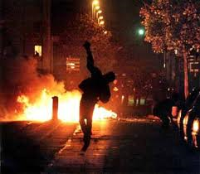
The Critical Period 1780’s
Peace brought economic and political problems into focus
States fought, created own armies, and made agreements with other nations
States created own money w/ no backing of it.

Slide 9
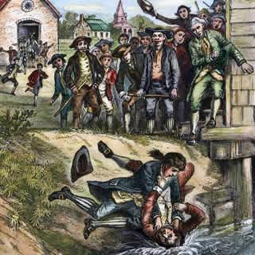
Shay’s Rebellion
1786
Mass. Farmers owed money on land
Never paid for fighting in the Revolution
Mass. Investors closed on mortgages
No court system to solve the problem
Raid on Mass. Armory
Shays rebellion

Slide 10
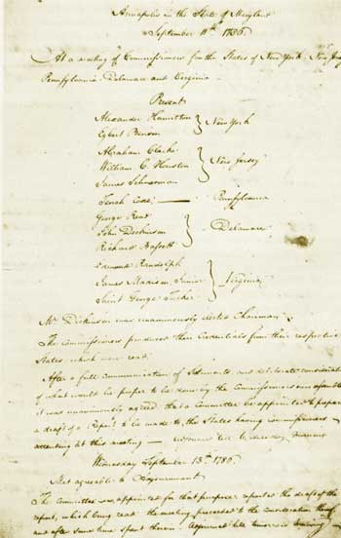
Annapolis Convention
Sept. 11, 1786
Only 5 of 13 states arrive to discuss commerce
Leads to Constitutional Convention
Summary

